Slide 1


TalkJourney
Bridging the Confidence Gap through Task-Based Interaction
Reuven Itzhakov & Peleg Canfi
Supervisor: Moshe Sulamy
Code: 26-1-D-20

Slide 2






The Confidence Gap
The Current Situation & The Need
Traditional Learning
Global Context
High demand for second language proficiency in a globalized world.
The Market
Saturated with mobile apps (Duolingo, Babbel) focusing on text-based drills.
The Limitation
Current tools build Passive Vocabulary (Reading/Listening) but fail to develop Active Fluency (Speaking).
The Need
A solution that forces active speech production in a pressure-free environment.

Slide 3



The Confidence Gap
Traditional Learning
Mobile apps focus on passive vocabulary, not active communication.
Low retention rates, lack of engagement.
Classroom anxiety inhibits speaking practice.

Slide 4





The Confidence Gap
Key Features & Pedagogy
TalkJourney's Solution
Immersive VR game: voice is primary controller.
Safe, judgment-free practice environment.
Task-Based Learning: language for specific goals.

Slide 5




Key Features & Pedagogy
Communicative Method
Simulate real-world scenarios: ordering food, interacting with service providers.
Gamification
Quest Objects, XP system, unlockable achievements for motivation.
Transliterator
Aids pronunciation by converting text to phonetic representations.
Voice Detection
Immediate feedback with interactive NPCs in a safe practice environment.

Slide 6






System Overview: Speech-to-Action Loop
TalkJourney is a VR application built on Unity, optimized for standalone VR headsets.
Processing
Voice Recognition analyzes phonetics, matches Vocabulary Bank.
Input
Audio captured via HMD microphone.
Feedback
Game Logic Controller triggers visual/auditory feedback.

Slide 7
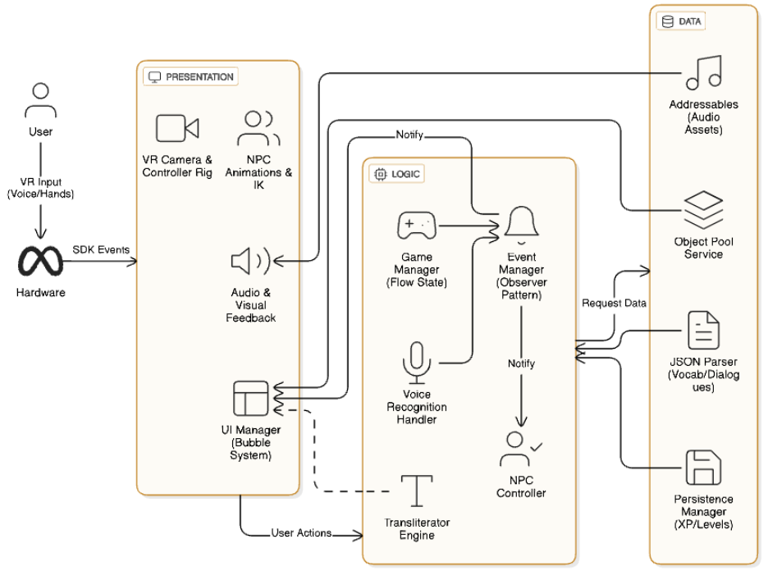
Functional Requirements: Core Mechanics
Voice Detection & Fallback
Primary input is voice; manual bypass after 3 failed attempts.
UI & Feedback
Visual voice indicator, haptic feedback, smart menus with translation.
Bubble System
Selection, Display, and Sentence Bubbles for vocabulary and sentence building.
Progression & Persistence
XP system for levels, local save for vocabulary and stages.

Slide 8
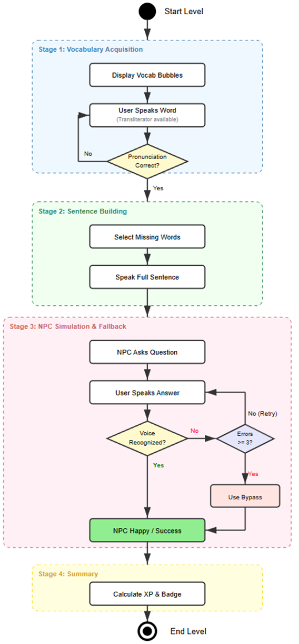
Game Flow: User Journey
01
Warm-up Phase
Guide introduces vocabulary with Display Bubbles and Transliterator.
02
Sentence Building
User completes sentences using Selection Bubbles.
03
Guided Practice
Interact with NPCs in simulation (e.g., restaurant) using learned sentences.
04
Summary
Performance review, XP, and Badges for reinforcement.

Slide 9
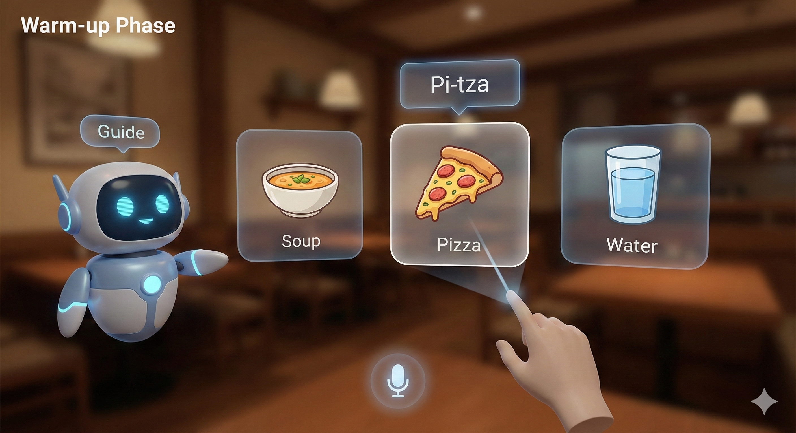
Game Flow: User Journey
Warm-up Phase
Guide introduces vocabulary with Display Bubbles and Transliterator.

Slide 10
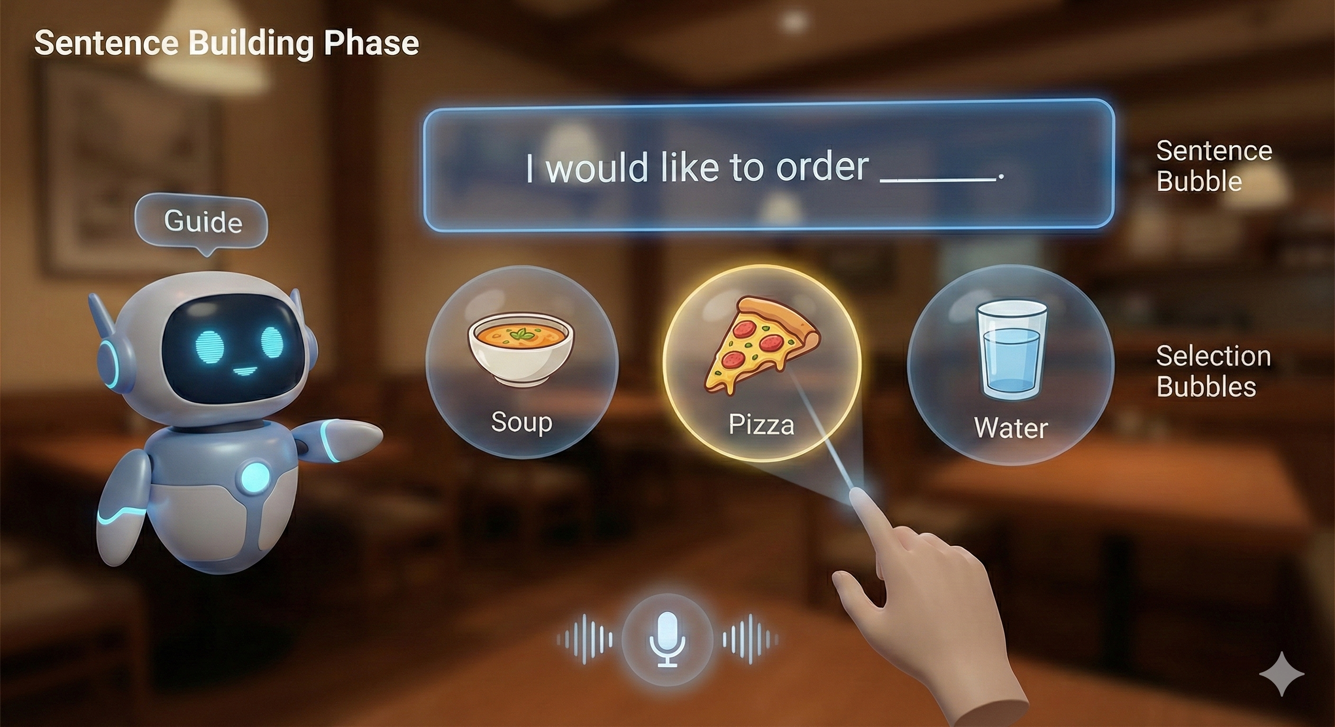
Game Flow: User Journey
Sentence Building
User completes sentences using Selection Bubbles.

Slide 11
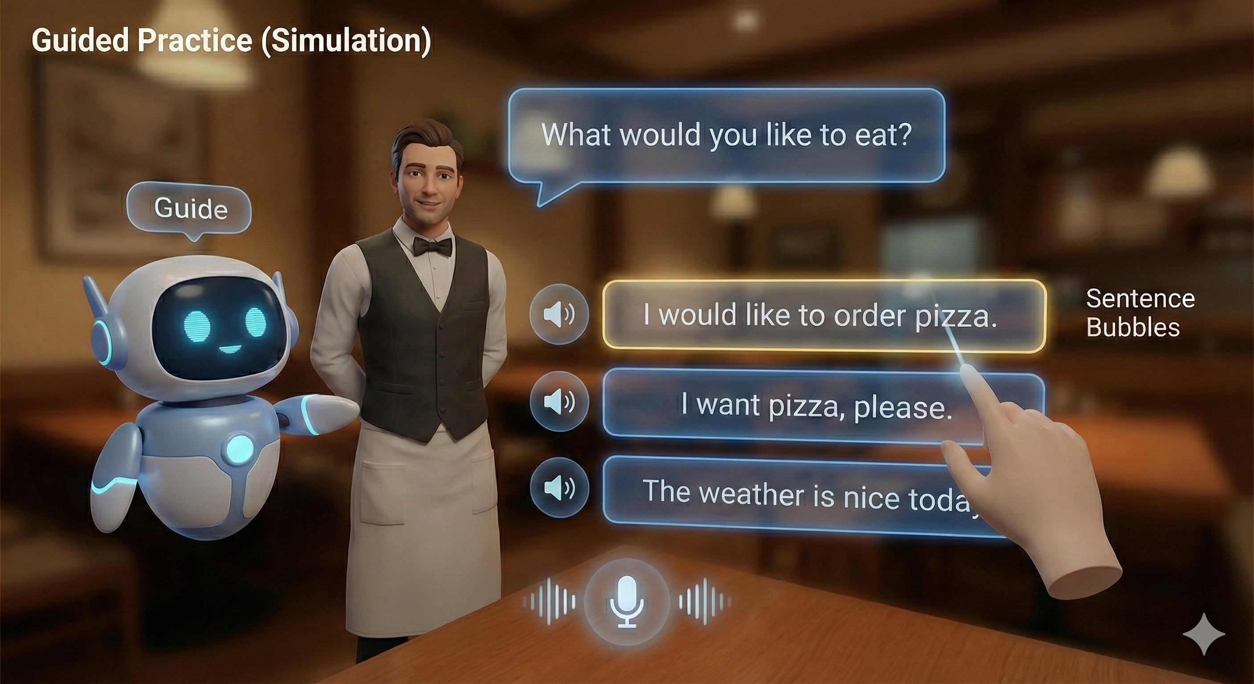
Game Flow: User Journey
Guided Practice
Interact with NPCs in simulation (e.g., restaurant) using learned sentences.

Slide 12
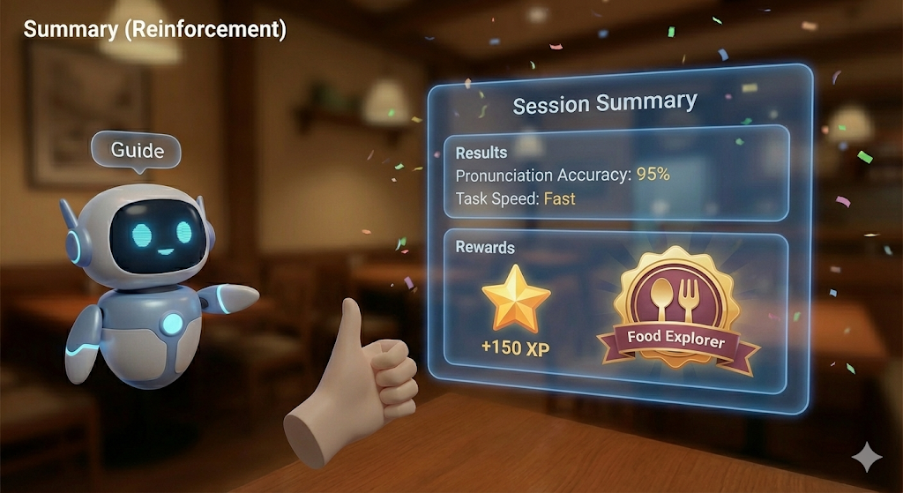
Game Flow: User Journey
Summary
Performance review, XP, and Badges for reinforcement.

Slide 13





Success Metrics: Measuring Impact
Pedagogical Effectiveness
Usability & User Experience
Vocabulary Retention: 80% complete "Guided Practice" without bypass.
Task Completion: "Warm-up" tutorial in < 3 minutes.
Comfort: < 10% report nausea after 10-min session.
Pronunciation: 85% voice detection success (1st/2nd attempt).
Technical Performance
Speech Recognition Reliability
Frame Rate: 40 FPS (95% of gameplay), no drops below 20 FPS.
Fallback Rate: "Bypass" triggered in < 5% of interactions.
Latency: < 500ms for visual feedback after speaking.
False Rejection: < 10% false negatives for valid speech.

Slide 14
Comprehensive Testing Plan
Unit Testing
Integration Testing
Usability & VR Experience
Verify individual scripts: data loading, object pooling, save/load system.
Subsystem communication: voice-to-action, fallback trigger, event propagation.
Motion sickness, height calibration, feedback perception.
Performance Testing
Acceptance Testing
Frame rate stability (40 FPS), memory usage (Object Pool).
Verify features against requirements: NPC head tracking, guide behavior, bubble interaction.

